Slide 1
Salary Prediction EDA
By: Mostafa Noaman Ahmed

Slide 2
Agenda
Salary Distribution
Gender Distribution
Age vs Salary
Sex vs Salary
Ratings Distribution
Past Experience vs Salary
Average Salary Over the Years
Leaves Used vs Leaves Remaining Over the Years
Most Common Designation and Unit Over the Years
Most Common Sex Over The Years
Correlation heatmap

Slide 3
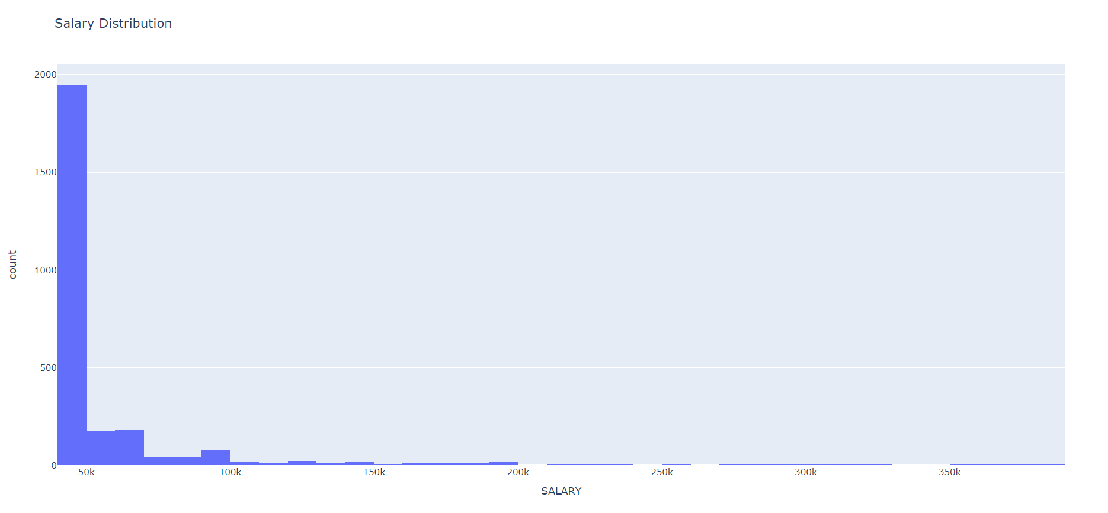
Salary Distribution
It shows the salary distribution per people.
Most of the people’s salary is in the range of 50k.

Slide 4
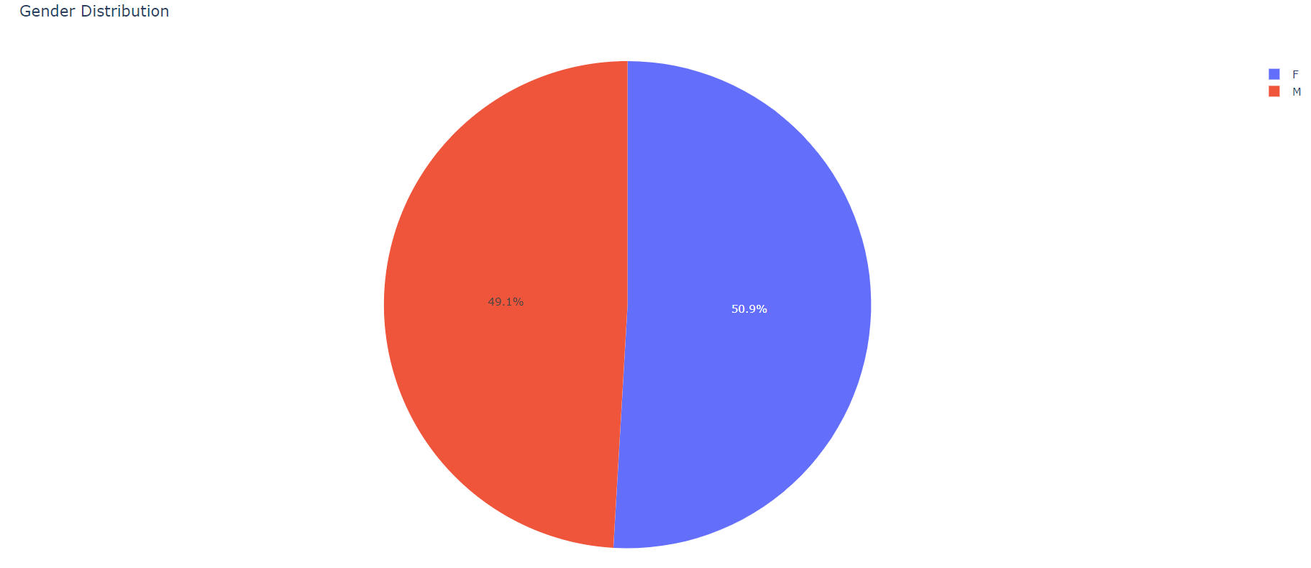
Gender Distribution
The percent of males seems to be equal to the percent of females, but the females still a bit more.

Slide 5
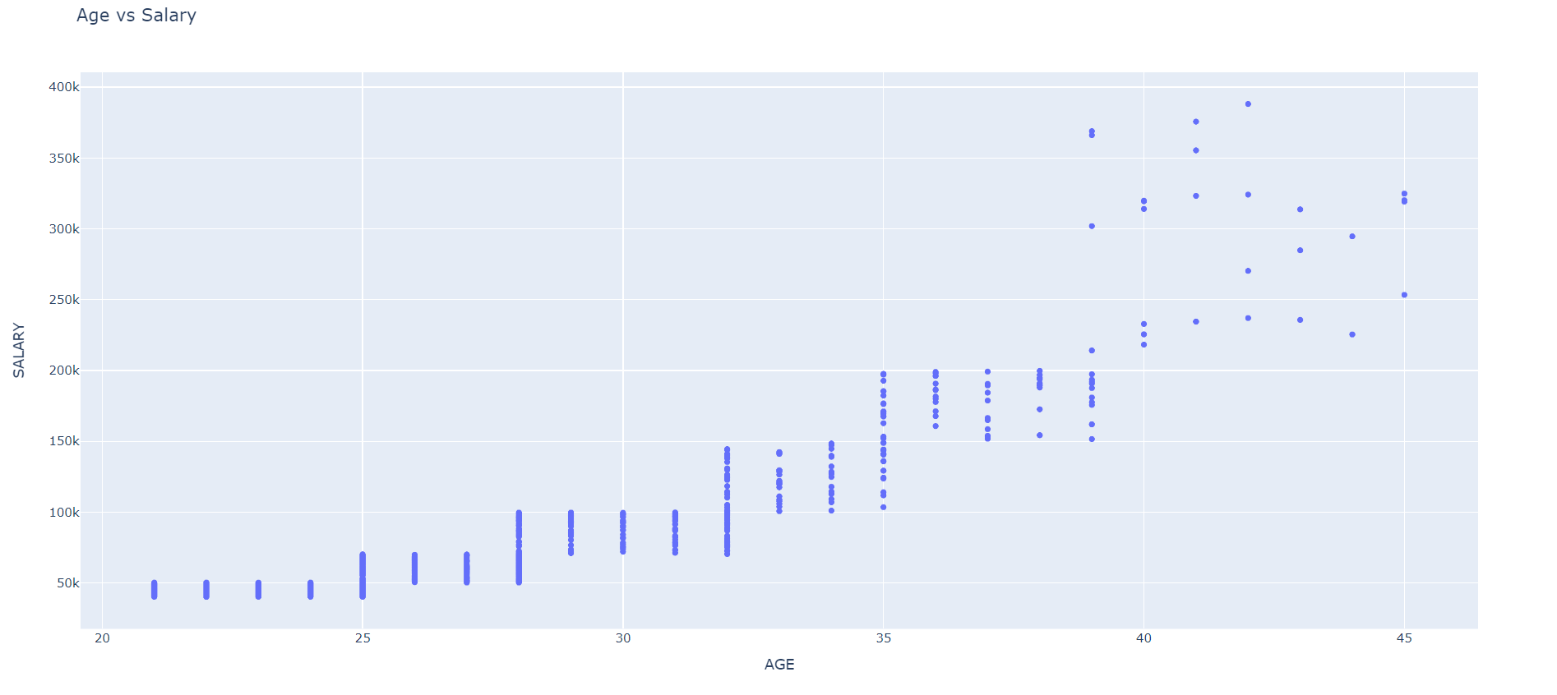
Age vs Salary
Salary increases as older the person is.
Very little amount of people seems to have higher salaries.

Slide 6
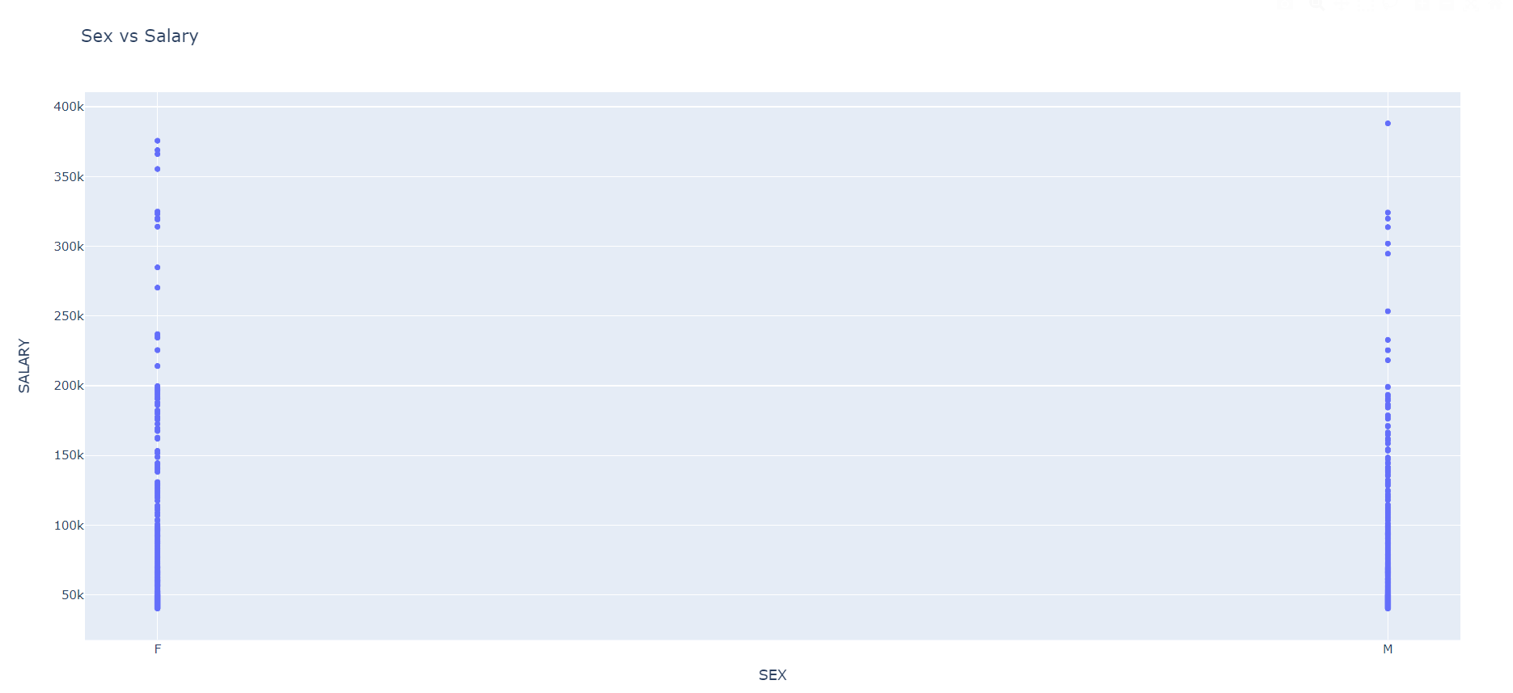
Sex vs Salary
Actually, the number of females that takes high income is greater than that of males.

Slide 7
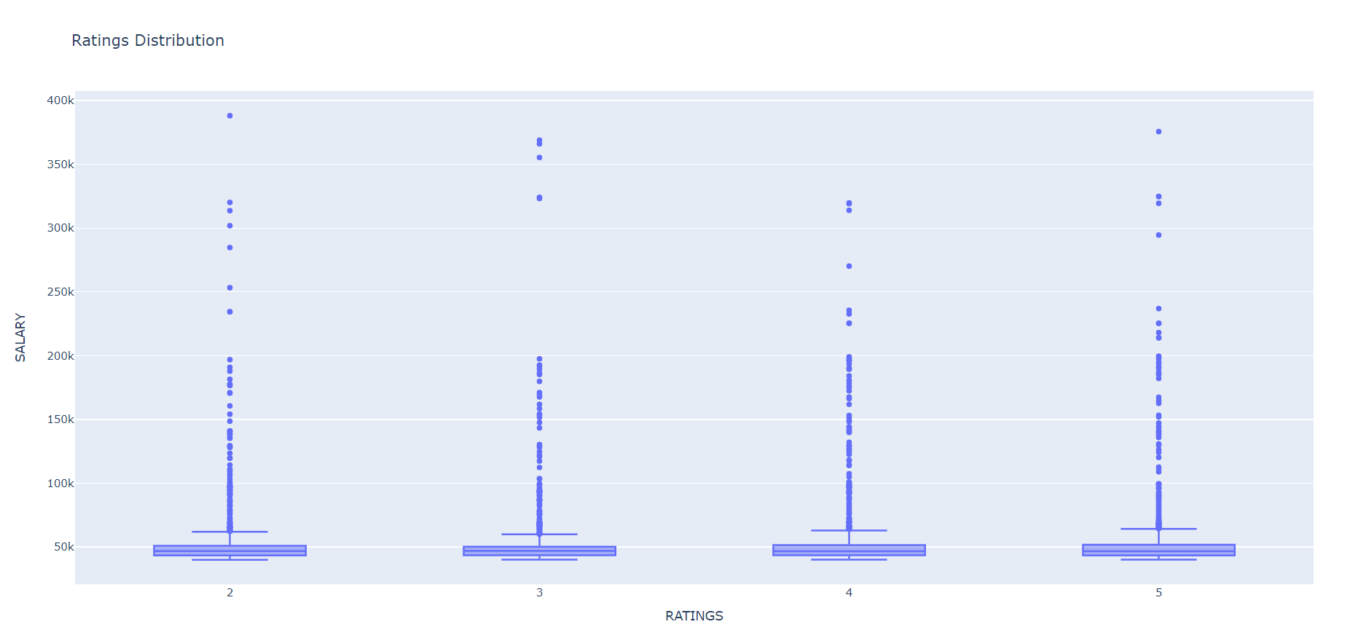
Ratings Distribution
Rating of the person seems not affect the salary by the way.

Slide 8
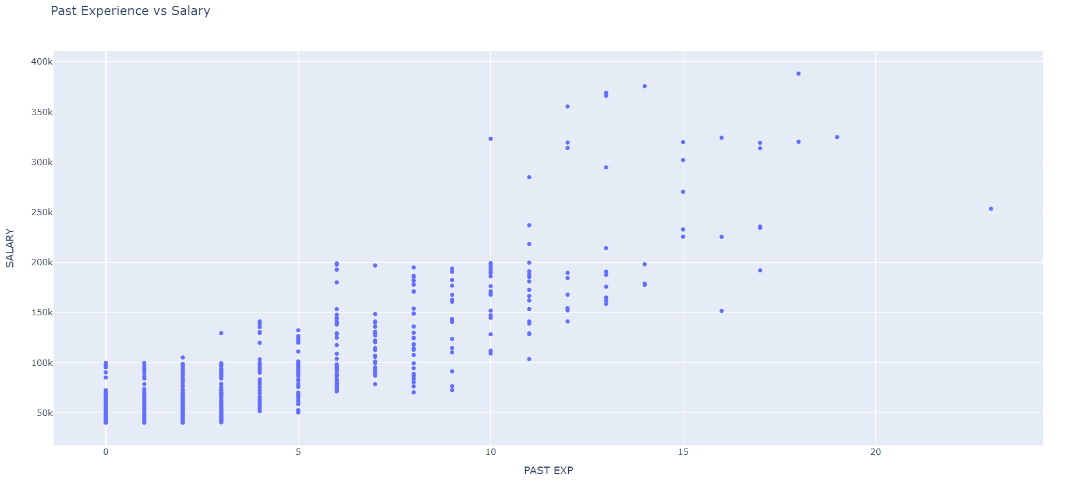
Past Experience vs Salary
At most, Salary increases as experience increase EXCEPT if you’re unlucky person.

Slide 9
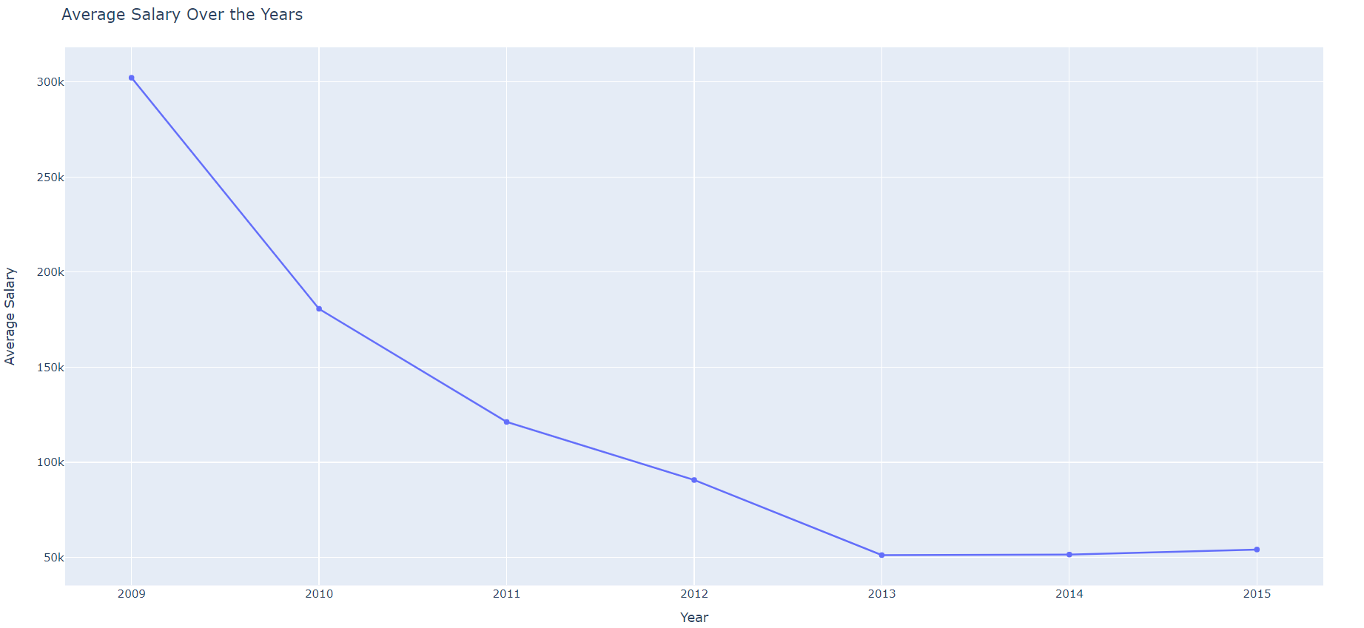
Average Salary Over the Years
It seems that salaries are decreasing as we move towards the future.

Slide 10
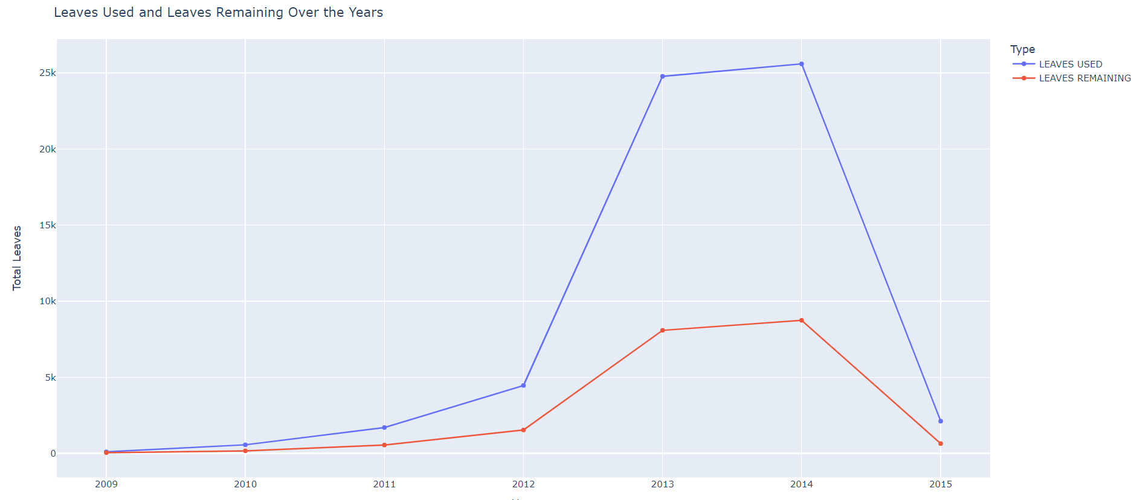
Leaves Used vs Leaves Remaining Over Years
It seems that paper consumption decreases we move towards the future.

Slide 11
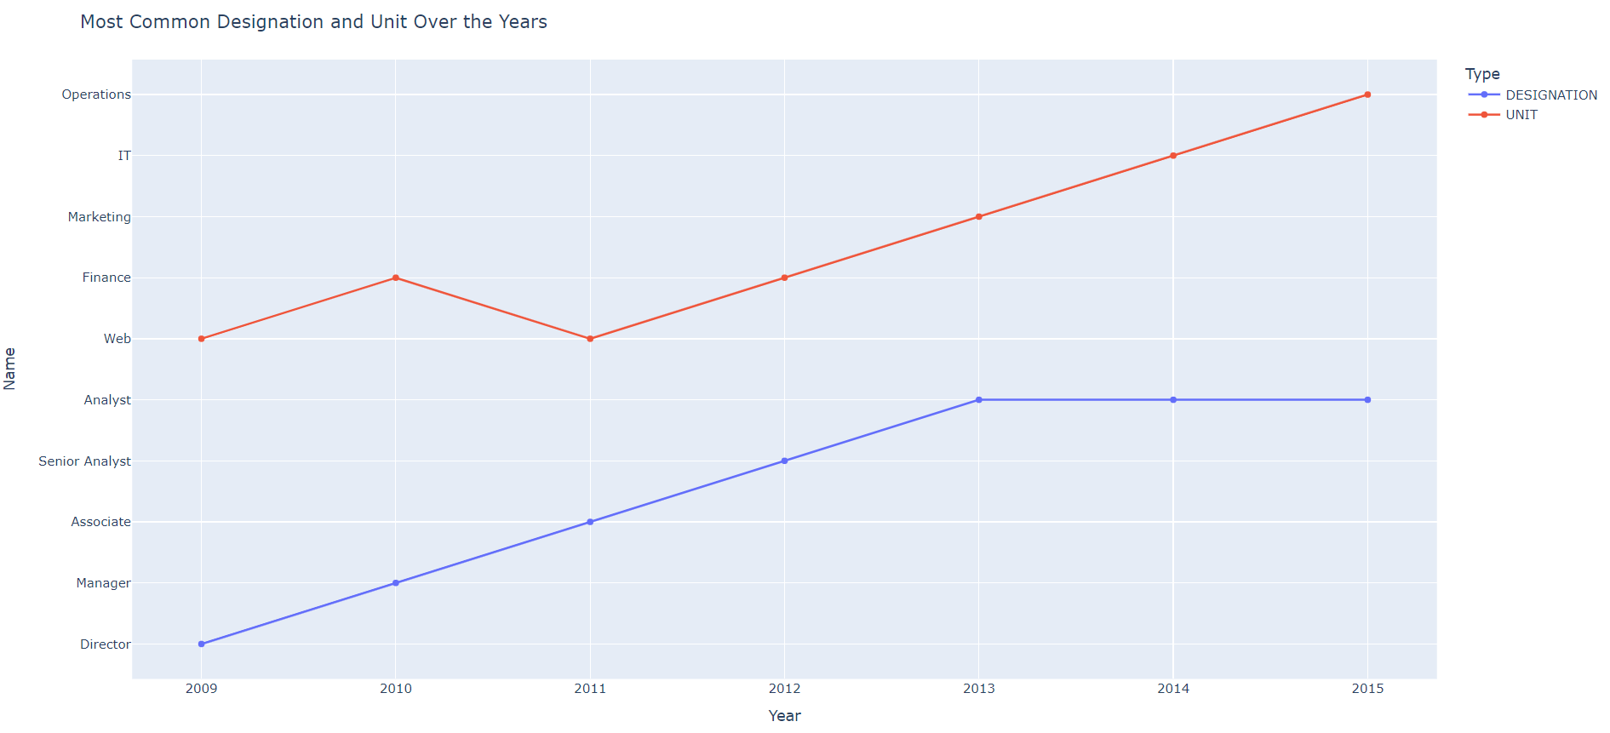
Most Common Designation and Unit Over the Years
Comparing the 5 Upper jobs with the 5 lower ones in terms of most common one per year.

Slide 12
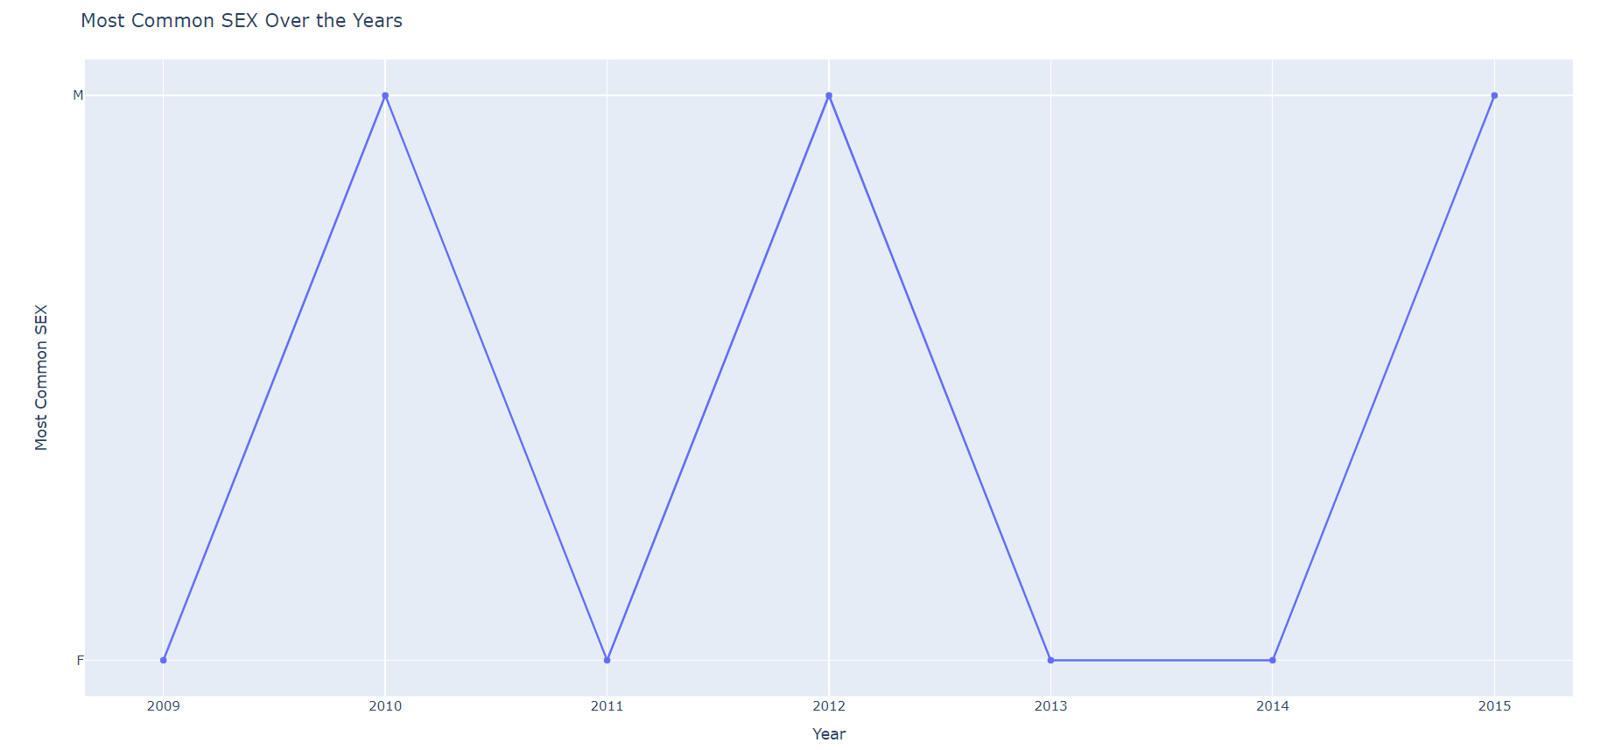
Most Common Sex Over The Years
Shows the most common sex in that are working per year

Slide 13
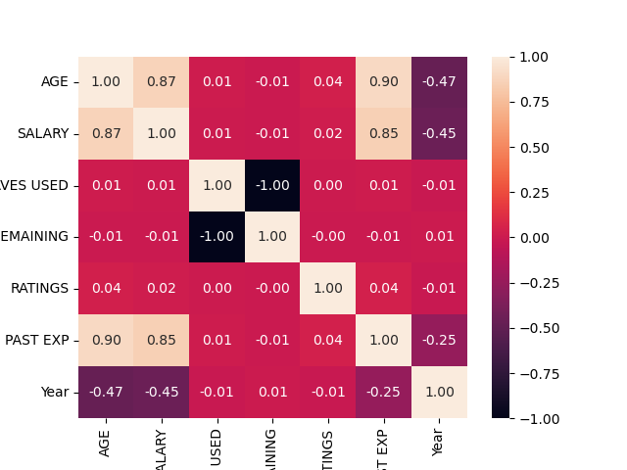
Correlation heatmap
Shows which of the current feature affects the Salary.

Slide 14
Thank you

